Slide 1

Taming the Concurrency Crocodile
Duncan Jones

Slide 2
What is the problem?
Get state
Act on state
t
>> projection
>> append
Notes:
At the most basic level nearly every business process being executed on a computer program can be distilled down to two parts: 1) Get the current state of something 2) Do some action based on that current state
The problem is that in a multi-threaded, multi user, multi everything world the state may change in the time it takes us to act on it.

Slide 3


Solution 1: Transactions
Get state
Act on state
t
‘Solved’ technology
Doesn’t scale well
Notes:
Transactions – specifically fully ACID database transactions are the most common solution

Slide 4
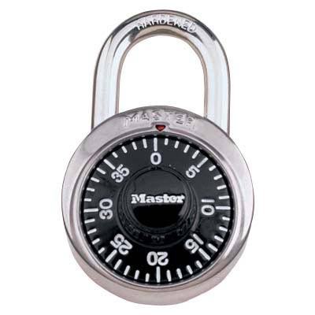
Solution 2: Locks on crocs
Get state
Act on state
t
Relatively simple technology
Needs safety net to force-unlock in the event of an error
Notes:
Locking to prevent concurrency errors – this is how many transactions actually work but you can also implement a locking solution of your own. (Don’t… but you can)
However both transactions and locks solve the concurrency problem by change prevention – which is not always something that your particular business can tolerate.

Slide 5
Solution 3: Undo, redo, undo….
How do I know if there has been any change?
As at…
Get state
Act on state
?
t
UNDO
Very efficient if contention rates are low
Much more complicated code
Notes:
An alternative is to allow the arrow of time to continue and check as, or after you have acted on the state whether that state was still valid.
Step 1: Check if the state has changed. In an event sourced system you can do this by retrieving the event number of the top event read while projecting the state and then comparing it against the top event when you come to write the event(s) that are the action and if they do not match you know that some concurrency issue has occurred.
Step 2: Perform whatever compensating action is needed to undo the state change if it should not have been allowed to happen…

Slide 6
Solution 3 (b): Re-run
How do I know if there has been any change?
As at…
Get state
Act on state
?
t
?
RETRY
Very efficient if contention rates are low
Risk of getting “stuck”
Notes:
An alternative is to allow the arrow of time to continue and check as, or after you have acted on the state whether that state was still valid.
Step 1: Check if the state has changed. In an event sourced system you can do this by retrieving the event number of the top event read while projecting the state and then comparing it against the top event when you come to write the event(s) that are the action and if they do not match you know that some concurrency issue has occurred.
Step 2: If the state has changed, don’t apply the action but rather try the whole command again

Slide 7
Solution 4: Look behind you…
Get state
Act on prior state
t
Very easily achieved in event sourced
systems
Requires understanding of the impact to
The business and not always applicable
Notes:
Changing business conditions for “is” to “was”

Slide 8

Wrapping it up
LATENCY
COST OF “INCORRECT” STATE
BUSINESS RULES ON HISTORICAL STATE
GEOGRAPHIC DISTRIBUTION
AVAILABLE TECHNOLOGY
IT DEPENDS….
Notes:
Of course it depends…
If your system is a line of business type of system that has operates synchronously and the user interface is interacting with humans then one of the two change prevention strategies will be easiest. In practice this would nearly always mean relying on transactions provided by the underlying storage technology.
The optimistic concurrency of an undo-redo-undo or saga process is a better option of asynchronous systems and anything connecting to wait intolerant systems.
Rewriting the business rule to work behind the current state is, of course, something that needs to be discussed with the business but there are many business domains that have operated in a distributed model that already cater for this way of operating.

Slide 9
Other possibilities
Do nothing
Actor model
Merge state

Slide 10


Slides source
github.com/MerrionComputing/Presentations
Duncan Jones
💬@Merrion

